Slide 1

M-Care:
Crafting Beauty from Sanitary Waste
Team:
Sakshi Joshi
Ritik Pandey
Bhavesh Nanda
Yash Kelhe
Dhruv Dalvi
College:TSEC, Bandra (W)
Department: EXTC

Slide 2
Problem Statement
Safe disposal of sanitary napkins is essential for menstrual hygiene management, but it poses complex challenges to the environment, public health, and social standards.
Poor infrastructure, ignorance, and environmental impacts hinder proper disposal of sanitary napkins.
Non-biodegradable materials accumulate in landfills, leading to pollution and serious health risks.
Increasing use of sanitary napkins, especially in educational institutions, healthcare facilities, and public areas, highlights the urgent need to address this issue.

Slide 3
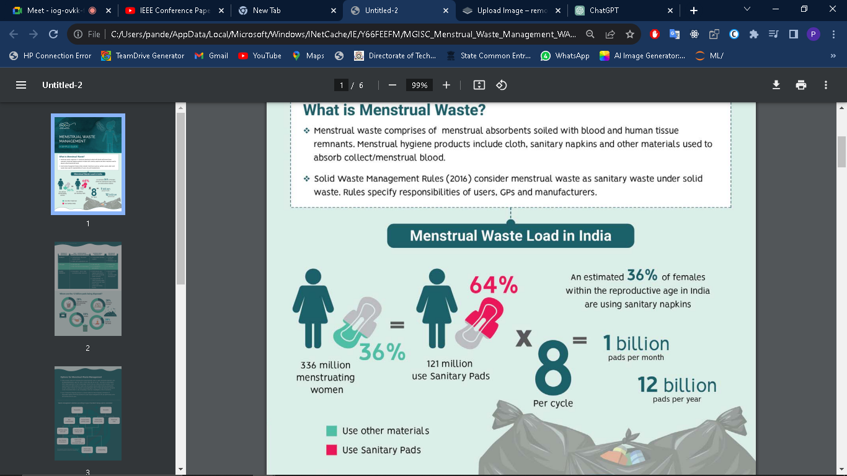
Menstrual Waste Load in India :
4

Slide 4
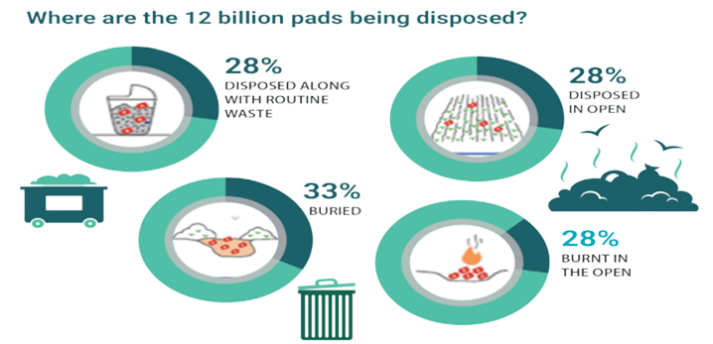
Where are the 12 Billion pads being disposed?

Slide 5
Proposed Methodology
Introducing M-Care, a groundbreaking solution that uses a comprehensive system to integrates smart technology and waste upcycling to address issue of sanitary napkin waste management.
M-Care is a crucial step towards sustainable menstrual hygiene management, with potential for significant upcycling and waste reduction.
M-Care aims to transform waste management practices through innovation.
M-Care consists of two primary components:
1. M-Care Bin
2. M-Care Up-Cycling Machine

Slide 6
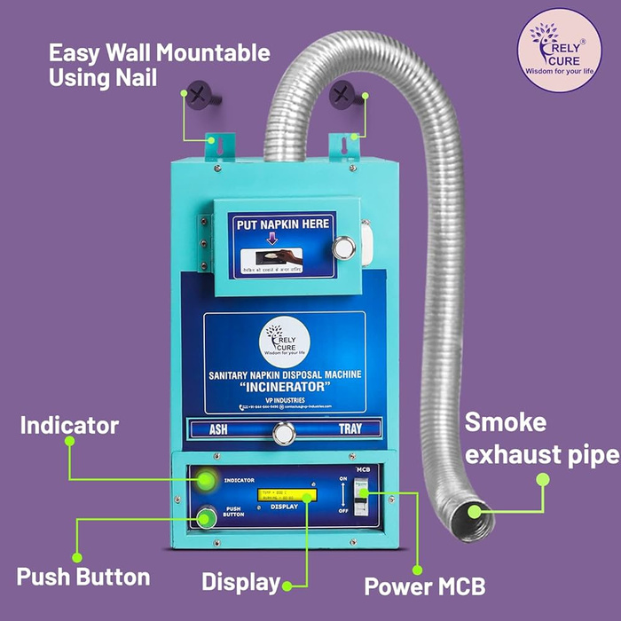
Market Research
Incinerators widely used for waste disposal.
Despite prevalence, incinerators pose significant environmental risks, mainly air pollution.
Combustion releases pollutants like particulate matter, carbon monoxide, nitrogen oxides, and dioxins.
Emissions from incinerators can cause respiratory issues, cardiovascular problems, and increased cancer risks, especially for vulnerable populations.

Slide 7
Working
M-Care Bin:
M-Care Bins strategically placed in commercial areas, residential areas, schools, and more for convenience.
Users locate nearest bins through our website.
Bin alert system notifies admins when full, ensuring timely collection and upkeep.
Designated executives collect filled bins for transportation to central warehouse.
This approach prevents overflow, ensuring cleanliness and user convenience.

Slide 8
Working
M-Care Upcycling Machine:
The M-Care Up-Cycling Machine is the heart of M-Care, which transforms used napkins into reusable materials through a series of processes.
The Upcycling Machine converts used napkins into reusable materials through multiple processes.
Process Overview:
Shredding: Breaks down napkins into smaller pieces.
Disinfection: Utilizes a disinfection process.
Chemical Treatment: Separates plastic components using chemical processes.
The machine produces Cellulose, a versatile material for various upcycling purposes.

Slide 9
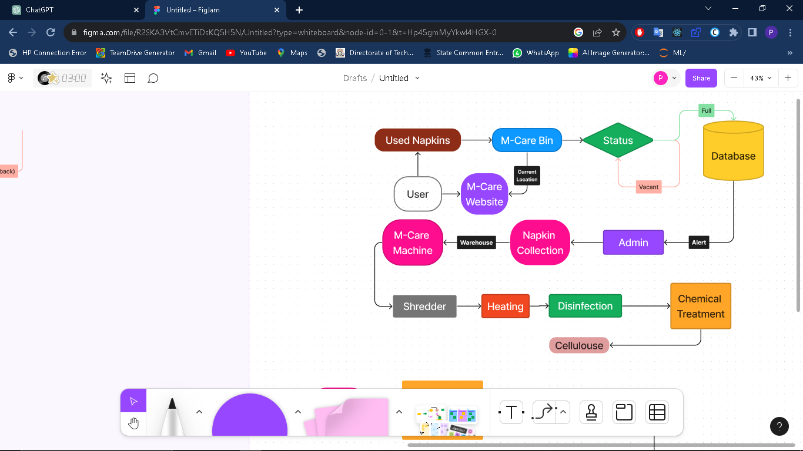
Process Flow :

Slide 10
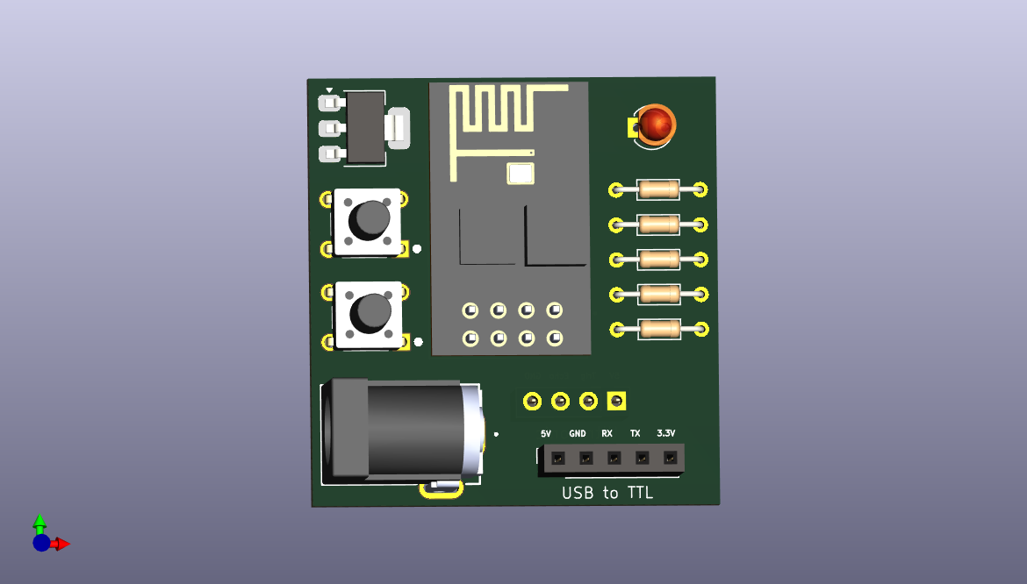
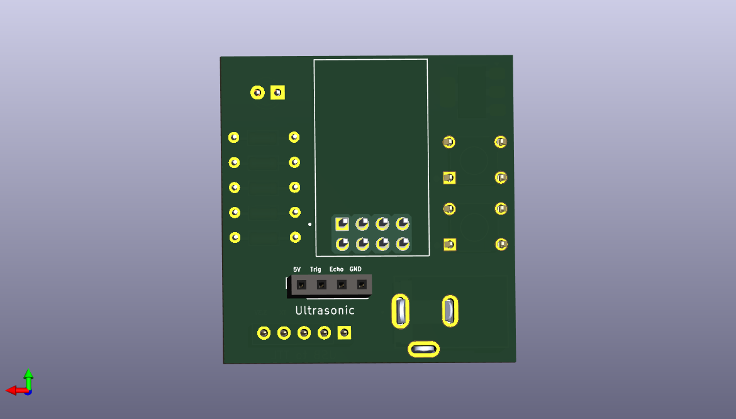
M-Care Bin Hardware :

Slide 11
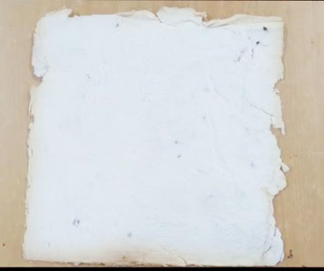
Result:
M-Care implementation and testing resulted in successful resource recovery from used sanitary napkins.
This led to the creation of eco-friendly paper with unique features such as texture and durability.
Usecases:
Paper and Cardboards
Arts and Crafts
Construction
Environmental Cleanups
Eco-Friendly Textiles

Slide 12
Conclusion
Neglected Issue: M-Care addresses overlooked sanitary napkin waste disposal.
Upcycling: M-Care promotes eco-friendly upcycling of napkin waste.
Sustainability: It contributes to environmental sustainability.
Health: M-Care ensures hygiene and well-being for communities.

Slide 13

M-Care Website : https://m-care.vercel.app/
M-Care Reserch Paper : https://ieeexplore.ieee.org/document/10520512
(Best Paper Award in IEEE Conference)
Full Paper : Research Paper

